Slide 1

BATCH NUMBER: 9 PROJECT PRESENTATION: SPEED DETECTION OF VEHICLE USING MACHINE LEARNING ALGORITHM TEAM MEMBERS RISHAV SURANA 18BTRIS035 SUSANTA SARKAR 18BTRIS48 SIDDHARTH Kr HARLALKA 18BTRIS066 SUJATA BUDHA 18BTRIS065 Guided by :Mr. Mathiyalagan R, Assistant professor, Dept. Of ISE, FET-Jain.

Slide 2
CONTENTS
Abstract
Introduction
Objectives
Literature Survey
Proposed Idea
Methodology
Dataset Training
Result
Conclusions
References
Poster

Slide 3
ABSTRACT
Object Detection is related to Computer Vision. Object detection enables detecting every instance of objects in images and videos. It identifies the feature of Images that generates an intelligent understanding of images just like human vision works. In this we begin with the brief introduction of machine learning and object detection framework like Region-Based Convolutional Neural Network (RCNN), You only look once (YOLO), Haar Cascade, Decision Tree etc. Then we focus on our proposed object detection architectures along with some modifications. The traditional model detects a certain object in images.
Vehicle detection and tracking is one of the key components of the smart traffic concept. Modern city planning and development is not achievable without proper knowledge of existing traffic flows within the city. Surveillance video is an undervalued source of traffic information, which can be discovered by variety of information technology tools and solutions, including machine learning techniques.

Slide 4
INTRODUCTION
Smart traffic in the modern cities ,vehicle recognition and route tracking.
It provides necessary information about traffic conditions like velocity distribution and density of vehicles.
It detects possible traffic congestion.
Accidents occur on the road frequently
The most common cause is rear-end collisions
Driver error such as fatigue, discomfort, over speeding or use of a phone while driving.
These accidents can be reduced if these driver errors are eliminated.

Slide 5
The Problem Statement
The task of detecting and classifying objects in images and videos are classification task.
The reason behind this is from the dataset with complex features.
Task is suited well in machine learning since the task is a perform by CV.
The system is important for many fields especially for traffic and vehicle detection

Slide 6
OBJECTIVES
The objectives are:
To design an automated over speed detection system.
To create a system that would notify traffic police with details of an over speeding vehicle.

Slide 7
LITERATURE SURVEY
S.NO. | TITLE | AUTHOR(S) | YEAR OF PUBLICATION | METHODOLOGIES | LIMITATIONS
1. | Video Tracking: Lucas-Kanade | Bruce D. Lucas, Takeo Kanade | 1981 | Optical Flow, Horn- Schunck method Kanade–Lucas–Tomasi (KLT) feature tracker | Assumption of constant flow (pure translation) for all pixels in a larger window is unreasonable for long periods of time.
2. | Image Segmentation in Video Sequences | Friedman, N. and Russell, S | 1997 | Background subtraction approach | Heuristic approach may not work well in extremes of lighting conditions
3. | Vehicle Tra jectory Approximation and Classication | R. Fraile and S. J. Maybank | 1998 | Hidden Markov Model (HMM | The trajectory classification method has only been applied to a limited number of trajectories.

Slide 8
S.NO. | TITLE | AUTHOR(S) | YEAR OF PUBLICATION | METHODOLOGIES | LIMITATIONS
4. | Video Image Processing to create a speed sensor | D.J. Dailey and L. Li | 2000 | Image Processing morphological operators: dilation and erosion | image processing techniques are applied to estimate travel speed from image sequences of moving vehicles
5. | Realtime multiple vehicle detection and tracking from a moving vehicle | M. Betke, E. Haritaoglu, and L. S. Davis | 2000 | Visions Algorithms, Spatial recursive least squares filter (RLS) | At night on city expressways, when there are many city lights in the background, the system has problems finding vehicle outlines and distinguishing vehicles on the road from obstacles in the background.
6. | Vehicle type classification from visual-based dimension estimation | Lai, AHS; Fung, GSK; Yung, NHC | 2001 | Background subtraction approach | Drawbacks are the performance is hindered by the accuracy of the vehicle mask and the estimated bumper to road surface height.

Slide 9
S.NO. | TITLE | AUTHOR(S) | YEAR OF PUBLICATION | METHODOLOGIES | LIMITATIONS
7. | Vehicle Speed Detection using Python | Md MUBEEN KHAN, K SRINIVAS, 3KAVITHA J | 2005 | LUCAS AND KANADE ALGORITHM, DBSCAN algorithm | errors on boundaries of moving object
8. | Video-based real-time vehicle detection method | Wang, Y.K. and S.H. Chen | 2005 | A two-level method is proposed Lane line Others Exponential forgetting algorithm | The proposed method is not suitable for vehicle detection at night when there is insufficient illumination.
9. | Foreground-Adaptive Background Subtraction | JM McHugh, J Konrad,V Saligrama,P Jodoin | 2009 | Adaptive background subtraction with Markov Random Field | The inclusion of a foreground model tends to grow the detected regions rather than shrink them.

Slide 10
S.NO. | TITLE | AUTHOR(S) | YEAR OF PUBLICATION | METHODOLOGIES | LIMITATIONS
10. | Speed Detection Camera System using Image Processing Techniques on Video Streams | Osman Ibrahim, Hazem ElGendy, and Ahmed M. ElShafee | 2011 | background subtraction technique with a three-frame differencing algorithm | Accuracy of frame differencing depends on object speed and frame rate
11. | Vehicle Speed Detection in Video frames using Corner detection | Kiran Kumar KV, Pallavi Chandrakant, Santosh Kumar, Kushal KJ | 2014 | Computer vision, Frames subtraction, Edge detection, Image segmentation, Corner Detection | Efficiency goes down to multiple vehicles. Focus should be on a single vehicle
12. | VEHICLE SPEED ESTIMATION BY LICENSE PLATE DETECTION AND TRACKING | Diogo C. Luvizon, Bogdan T. Nassu and Rodrigo Minetto | 2014 | SIFT and KLT algorithms, SNOOPERTEXT | Extracts data only when camera is closer to vehicle, errors on boundaries of moving object

Slide 11
S.NO. | TITLE | AUTHOR(S) | YEAR OF PUBLICATION | METHODOLOGIES | LIMITATIONS
13. | Vehicle Classiﬁcation using Road Side Sensors and Feature-free Data Smashing Approach | Denis Kleyko, Roland Hostettler, Wolfgang Birk, and Evgeny Osipov. | 2016 | Data Smashing Approach, KNN, SVM, Logical regression | Main drawback of data smashing usage is its moderate performance (76.8% vs. 93.4% for the state-of-the-art feature-based method) shown for largest data.
14. | Speed Detection using Image Processing | Pranith Kumar Thadagoppula, and Vikas Upadhyaya | 2016 | Matlab, Image processing, background subtraction | Tracking the objects detected frame by frame
15. | Vehicle Speed Estimation using Image Processing | Fatima Afifah , Sharmin Nasrin , Abdul Mukit1 | 2016 | Image processing, Python, Opencv Lucas-Kanade-Tomasi algorithm | Vehicle might go undetected

Slide 12
S.NO. | TITLE | AUTHOR(S) | YEAR OF PUBLICATION | METHODOLOGIES | LIMITATIONS
16. | RESEARCH OF VEHICLE SPEED DETECTION ALGORITHM IN VIDEO SURVEILLANCE | Jin-xiang Wang | 2016 | three frame difference method and the background difference method | unable to get complete boundary information of moving object, sensitive to changes of the light, weather and other environmental conditions.
17. | Distributed and collaborative real-time vehicle detection and classification over the video streams | Seda Kul, Süleyman Eken, Ahmet Saya. | 2017 | Background subtraction SIFT and SURFs | It is only applicable for distributed real-time framework for vehicle detection and classification over the surveillance video streams.
18. | Vehicle Speed Detection from Camera Stream Using Image Processing Methods | Jozef Gerát, Dominik Sopiak, Miloš Oravec, Jarmila Pavlovicová | 2017 | Gaussian mixture model, DBSCAN clustering, Lucas-Kanade method | errors on boundaries of moving object

Slide 13
S.NO. | TITLE | AUTHOR(S) | YEAR OF PUBLICATION | METHODOLOGIES | LIMITATIONS
19. | An Adaptive Video-based Vehicle Detection, Classification, Counting, and Speed-measurement System for Real-time Traffic Data Collection | Amit Ghosh, Md. Shahinuzzaman Sabuj, Hamudi Hasan Sonet, Swakkhar Shatabda, and Dewan Md. Farid | 2019 | Java programming language and computer vision | Tackling shadows, occlusion of multiple vehicles that appear in a single region
20. | Real-Time Detection of Vehicle Speed Based on Video Image | Cheng, G., Guo, Y., Cheng, X., Wang, D., & Zhao, J. (2020) | 2020 | Background subtraction method based on KNN algorithm | Moving target detection, moving target tracking

Slide 14
SUMMARY LITERATURE SURVEY
The above survey papers provides a detailed study of the various techniques that are used in traffic surveillance. It focuses on various techniques of vehicle detection from every corner, classification and tracking to make an efficient traffic management system by the use of video surveillance and many more techniques. The overall study gives a better understanding and highlights the issues and solutions for traffic management systems

Slide 15
PROPOSED IDEA
Dataset Collection
Implementation of Algorithm
Detection, Tracking and Speed Estimation
Result and Discussion

Slide 16
METHODOLOGY
Dataset
Input Data
Machine Learning Algorithms
Haar Cascade
You Only Look Once
Results

Slide 17
ACTIVITY DIAGRAM
Start
Selection of Target Area
Initialisation of System and Recording Images/Videos
Transfer Images to System
Pre processing
Vehicle Detection
YES
NO
Generate Alert if un-precedented event occurs
Over speeding?
Keep recording Vehicle Data for Future Traffic Management
Maintain data and Evidence of the Event occured
End

Slide 18
H/W AND S/W COMPONENTS
Hardware Requirements
Processor: Intel processor i5(or above).
RAM: at least 8 GB RAM
Hard Disk: 500 GB
Software Requirements
Language used: Python
Operating System: Windows, Linux- Ubuntu, Macintosh
Platforms: Jupyter, Spyder, Anaconda prompt, Virtual Box, Visual Studio.

Slide 19
Dataset Training
First approach includes using our own trained dataset using cascade trainer GUI.
First we collect dataset of vehicle and non-vehicle images.
Creating sub folders of positive and negative images.
Giving path to a root directory.
Configure according to the requirement.
Output :- receiving a cascade.xml file.

Slide 20
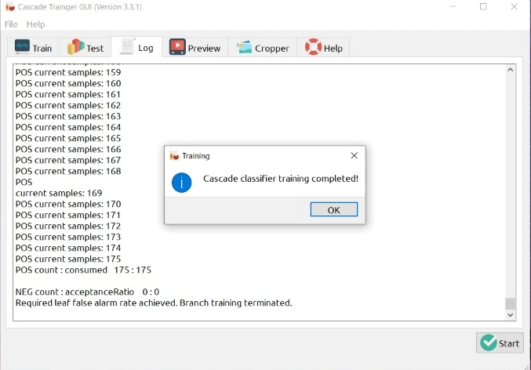

Training

Slide 21
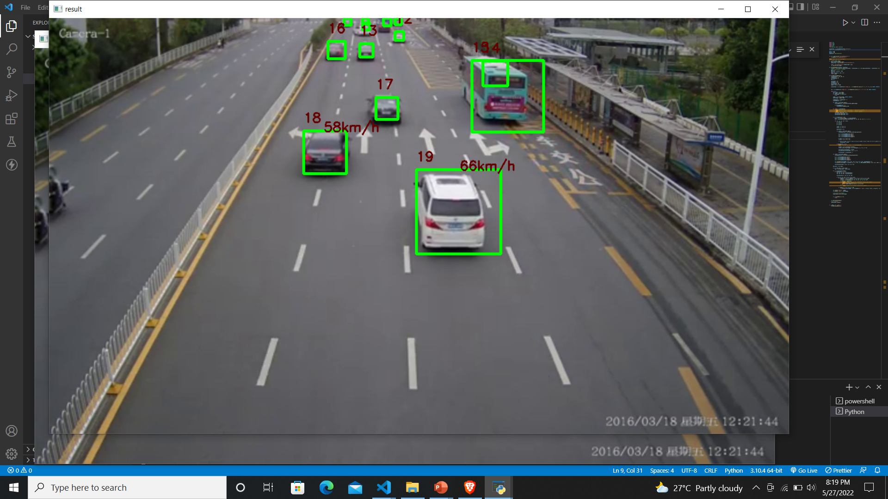
Result

Slide 22
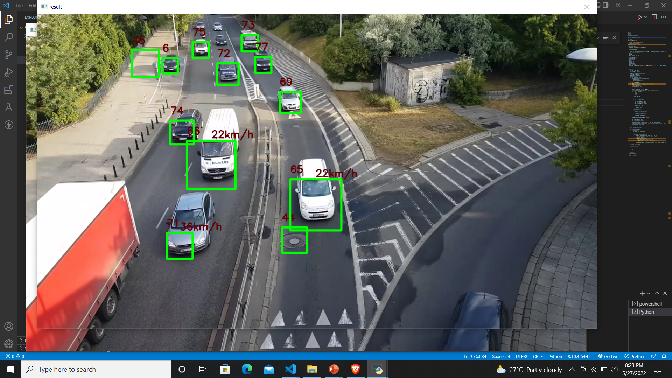

Slide 23
Conclusion
Speed estimation is one of many important parts of Intelligent Traffic System (ITS) which can be done by using image processing technique. It is more efficient and economical than conventional technique without using image processing, for example: using speed radar and manual inspection.
So, by this system we can reduce man power. It can become more effective and reliable.

Slide 24
REFERENCES
R. Reulke, A. Bœrner, H. Hetzheim, A. Schischmanow, and H. Venus. A sensor web for road traffic observation. In Image and Vision Computing, New Zealand 2002, pages 293–298, 2002
I. Ikeda, S. Ohnaka, and M. Mizoguchi. Traffic measurement with a roadside vision system - individual tracking of overlapped vehicles. In Proceedings of the 13th International Conference on Pattern Recognition, pages 859–864, 1996
M. Betke, E. Haritaoglu, and L. S. Davis. Realtime multiple vehicle detection and tracking from a moving vehicle. Machine Vision and Applications, 12(2):69–83, 2000
M. Arai, A. Otuki, K. Nakamiira, H. Inoue, Y. Satoh, T. Iiitamura, and Y. Kohayashi. Intelligent. monitoring system based on neural network t,heory and image processing. Proc. ITS’95 Yoboha.ma, vol. 1:170-173, 1995

Slide 25
Adnan, Muhammad Akram, Norliana Sulaiman, Nor Izzah Zainuddin, and Tuan Badrul Hisyam Tuan Besar. "Vehicle speed measurement technique using various speed detection instrumentation." In Business Engineering and Industrial Applications Colloquium (BEIAC), 2013 IEEE, pp. 668-672. IEEE, 2013
Chen, Peijiang. "Moving object detection based on background extraction." In Computer Network and Multimedia Technology, 2009. CNMT 2009. International Symposium on, pp. 1-4. IEEE, 2009.
Dailey, Daniel J., Fritz W. Cathey, and Suree Pumrin. "An algorithm to estimate mean traffic speed using uncalibrated cameras." IEEE Transactions on Intelligent Transportation Systems 1, no. 2 (2000): 98-107.
Madasu, Vamsi Krishna, and Madasu Hanmandlu. "Estimation of vehicle speed by motion tracking on image sequences." In Intelligent Vehicles Symposium (IV), 2010 IEEE, pp. 185-190. IEEE, 2010.
Madasu, Vamsi Krishna, and Madasu Hanmandlu. "Estimation of vehicle speed by motion tracking on image sequences." In Intelligent Vehicles Symposium (IV), 2010 IEEE, pp. 185-190. IEEE, 2010.

Slide 26

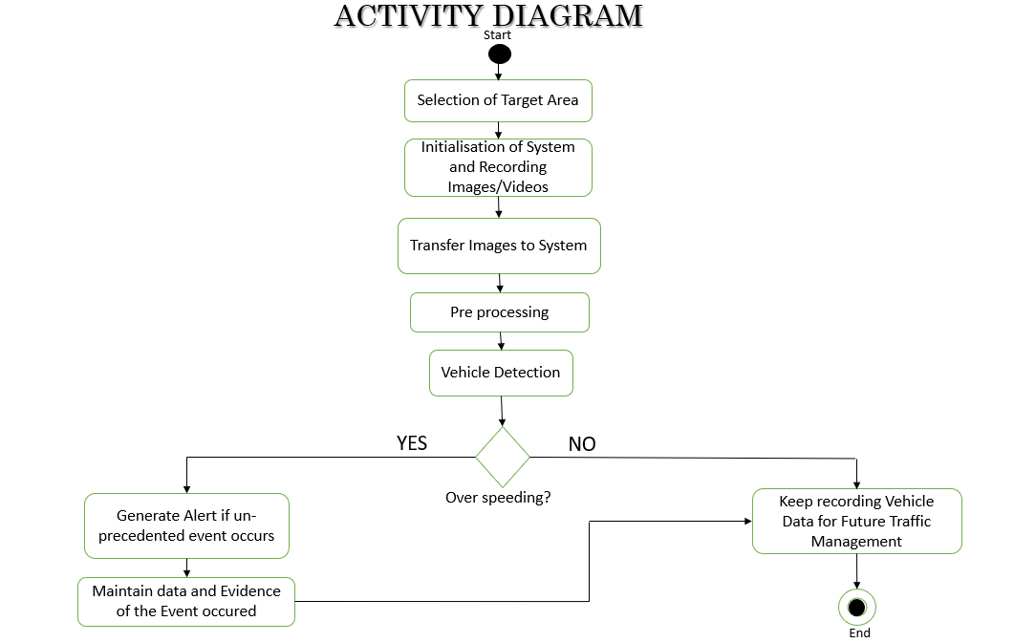
Speed Detection of Vehicle Using Machine Learning Algorithm
ABSTRACT
Images
CONCLUSION
Object Detection is related to Computer Vision. Object detection enables detecting every instance of objects in images and videos. It identifies the feature of Images that generates an intelligent understanding of images just like human vision works.. The traditional model detects a certain object in images. Vehicle detection and tracking is one of the main components of the smart traffic concept. Without having a proper knowledge of traffic flows we cannot plan and develop modern city. CCTV camera or surveillance is a source of traffic information which can be used to discover many information technology solutions, including ML algorithm.
PICTURES / DIAGRAM
Speed estimation plays vital role in Intelligent Traffic System (ITS) which can be done by using machine learning. It is more systematic or well organized and cheap or low-budget than conventional technique without using machine learning, for example: Police uses speed radar and manual inspection which is energy consuming. So, implementing this technology it can be helpful to reduce man power. As well as It can become more effective and reliable
OBJECTIVES
To design an automated over speed detection system.
To create a system that would notify traffic police with details of an over speeding vehicle.
REFERENCE
[1] Asaad AMA, Syed IA (2009). “Object identification in video images using morphological background estimation scheme” Chapter, 22: 279-288.
[2] R. C. Gonzalez, R. E. Woods, “Digital Image Processing” Third Edition, Prentice Hall, 2007.
[3] Wen L, Fumio Y (2009). “Speed detection of moving vehicles from one scene of Quick Bird images”, Urban Remote Sensing Joint Event, pp. 1-6.
ADVANTAGES
METHODOLOGY
Haar Cascade: It is an Object Detection Algorithm used to identify faces in an image or a real time video. The algorithm uses edge or line detection. The algorithm is given a lot of positive images consisting of faces, and a lot of negative images not consisting of any face to train on them. The models stored in XML files.
OpenCV: OpenCV is the huge open-source library for the computer vision, machine learning, and image processing and now it plays a major role in real-time operation which is very important in today’s systems. By using it, one can process images and videos to identify objects, faces, or even handwriting of a human
Smart traffic management
Reduce manpower
It is more efficient and economical than conventional technique
PARTICIPANT DETAILS
Under the guidance of Assistant prof: Mathiyalagan R
Rishav Surana:18BTRIS035 Susanta Sarkar: 18BTRIS48 Siddharth Kr Harlalka: 18BTRIS066 Sujata Budha: 18BTRIS065

